Slide 1



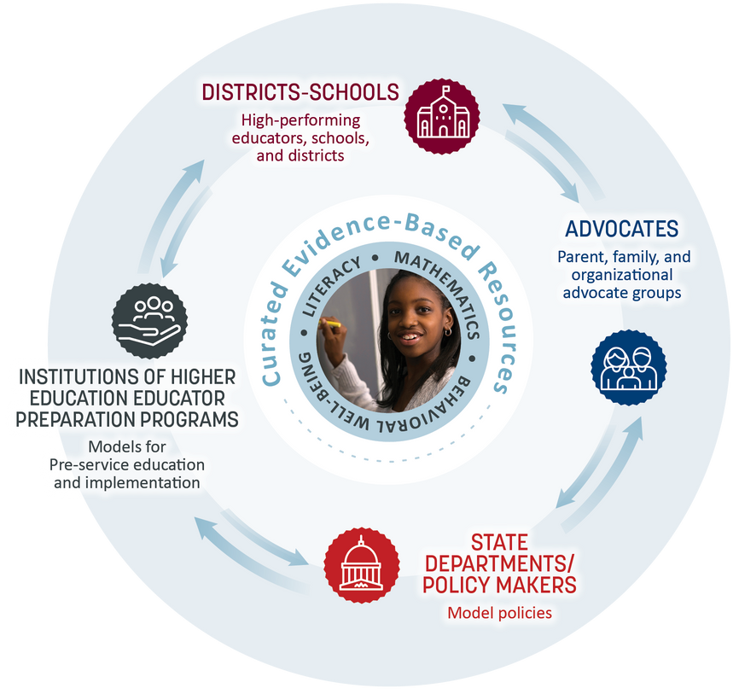



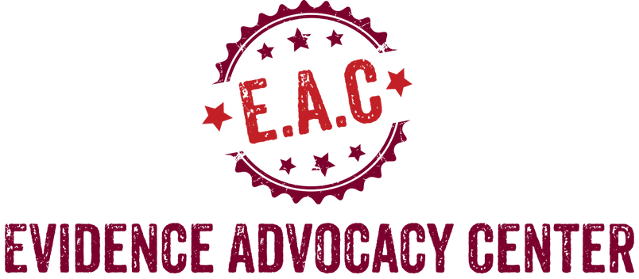

Every Student Deserves a High-Quality Education
That Prepares Them for Success
Evidence Advocacy Center ...
aims to transform education into a profession that relies on research for licensure, accreditation, continuing education, and accountability.
serves as a knowledge management system, an accessible repository of research-based practices and policies, for every component of the education system.

